Slide 1
Welcome!
Jeremy Haugen
EmBe FIRST LEGO League Coordinator for SD
jhaugen@embe.org

Slide 2
FIRST LEGO League has three components
What we do…
Robot
Project
How we do it…
Core Values

Slide 3
How we do it
We express the FIRST philosophies of Gracious Professionalism and Coopertition through our Core Values:
Discovery: We explore new skills and ideas.
Innovation: We use creativity and persistence to solve problems.
Impact: We apply what we learn to improve our world.
Inclusion: We respect each other and embrace our differences.
Teamwork: We are stronger when we work together.
Fun: We enjoy and celebrate what we do!
Gracious Professionalism
Coopertition – Cooperation and Competition together

Slide 4
What mentors/ coaches do:
Ask guiding questions.
Treat students with respect, listen quietly to their ideas, help students get to a solution.
Recognize that sometimes a student is just minutes away from solving a problem and patiently wait the extra time.
Maintain focus on the tasks at hand and when necessary by providing direction.
Look for that perfect balance - help when necessary, step back when possible.
Instead of assigning roles - involve students to formulate ways to place themselves in needed roles

Slide 5
The Challenge
Released August 1st
Check the Challenge Updates often
The guide is found at https://www.firstinspires.org/resource-library/fll/into-orbit-challenge-updates-and-resources
Four parts of an FLL competition
- Robot Game – 2.5 min to earn as many points as possible (3 rounds,
highest score counts)
- Robot Design Briefing – 5 min*
- Project Presentation – 5 min*
- Core Values – 5 min*
*be sure to leave time for questions

Slide 6
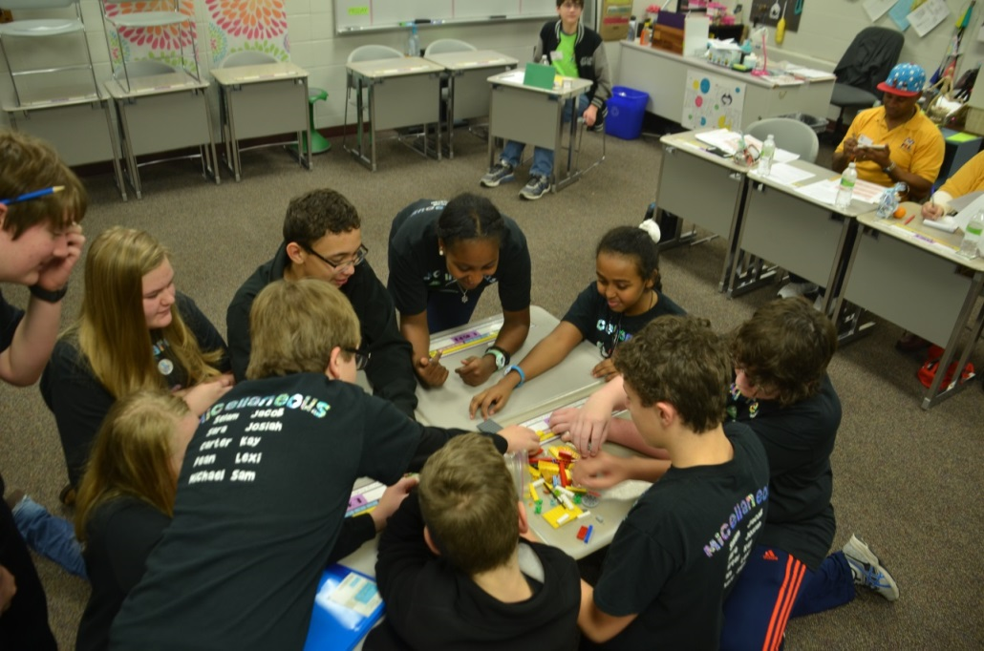
Core Values/ Team work Judged Session
Team is asked to perform a task.
Team answers questions from the judges on their team and teamwork.
Judges not looking for how well the task is completed, only how well they show the core values.

Slide 7
Core Values Judging Advice
Discuss core values as a team
As a team, memorize the core values (have each student pick one or two they really like and have them explain what it means to them). It’s a lot easier to remember just 1 or 2!
Before competition, practice teamwork activities – google “FLL teamwork” for ideas.
For core values judging, only the coach and assistant coach are allowed in the room as observers. This is a perk!
Team given task to complete and observations made on display of teaming and use of core values.
During Q/A, take turns answering questions. The Core Values Poster is only required for the State Championship.
Have Fun ☺

Slide 8
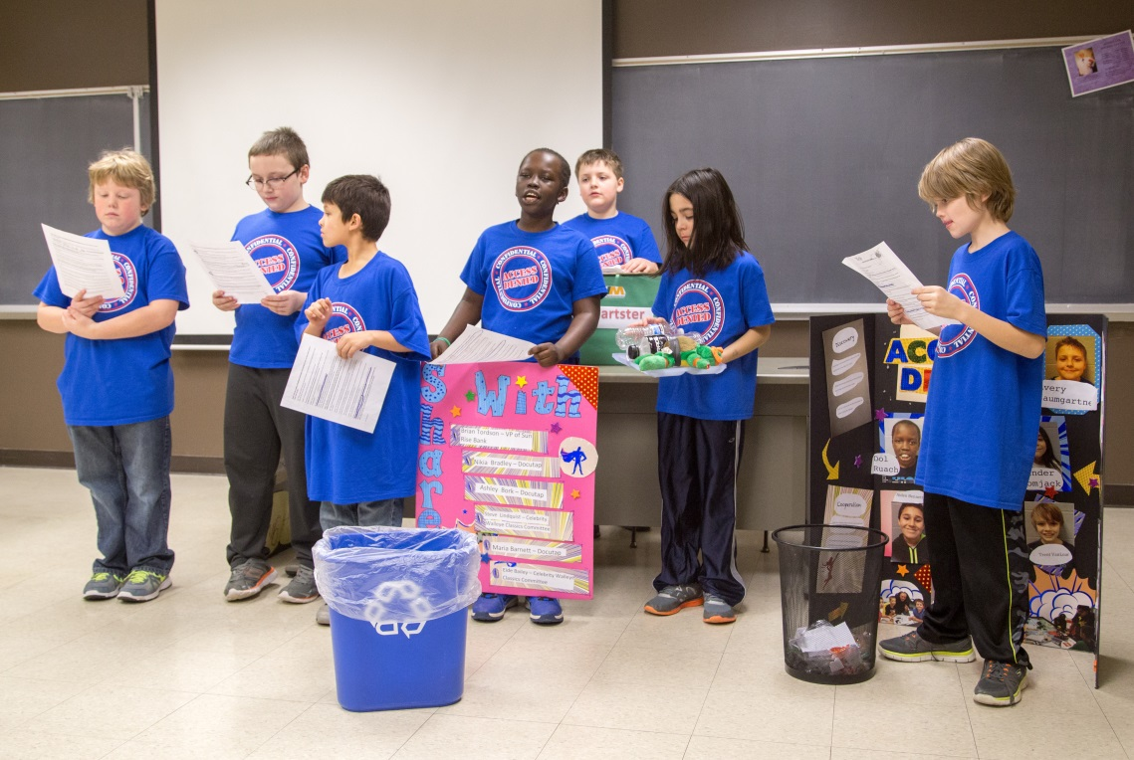
The Project Judged Session
Team has 5 min to present their research and innovative solution.
Team answers questions from the judges on project.

Slide 9
Project Presentation Advice
Creative solutions to the physical and social problems associated with space flight.
Be creative! With solution and how team presents solution.
All sorts of costumes, props, and methods can be used. Handouts are useful.
Before the competitions, share your presentation with others beyond parents.
Project presentations are open for all parents, guests, and participants to attend.
Team has 5 minutes total from when they enter the room to deliver their project solution. This includes setup time! Coaches can not help with set up.
Judges will not prompt the team to start as entering the room is the official start time.
Smile and…Have Fun ☺

Slide 10
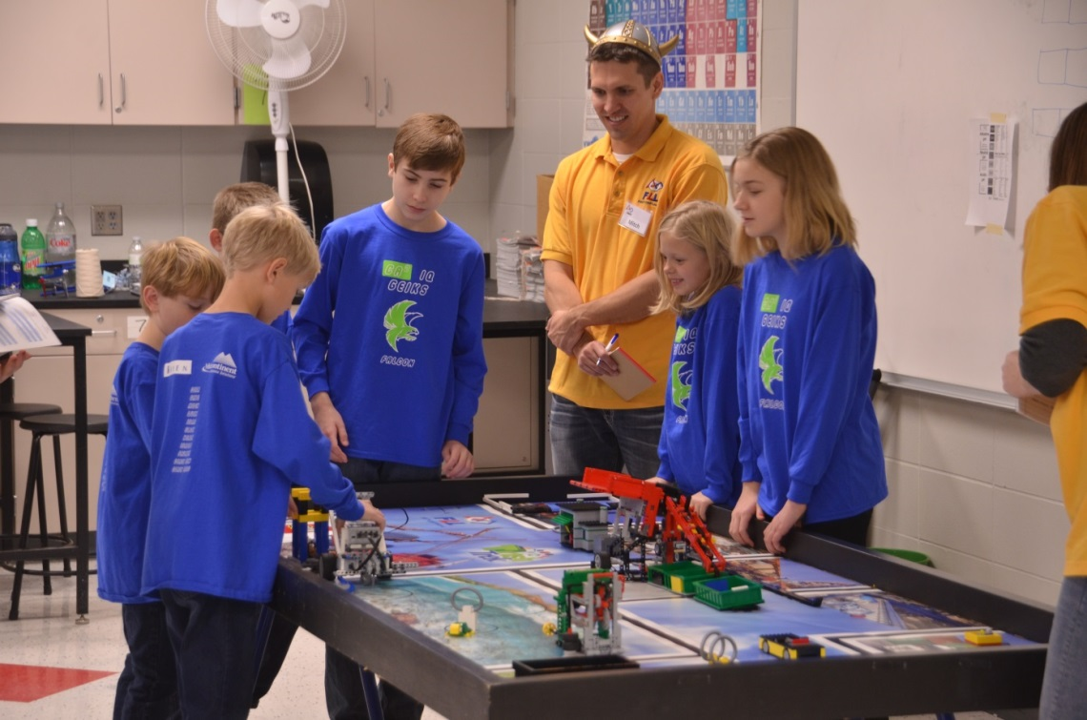
The Robot Design judged session
Teams tell the judges about their robot design, strategy and programming.
Judges ask to see the robot perform a mission and look at programs.
Robot Design Summary Worksheet can be helps focus discussion – only required at State though

Slide 11
Robot Design Advice
Changing the basic design of robot requires team to revise any programs already written, so finalize robot first!
Back bumper useful for making robot square to sides of table… back into them.
Pick missions based on reliability, point potential or fun!
Design attachments for quick assembly and removal.
Make a sketch of robot and attachments in case it falls apart
Advantageous to do multiple missions per run when possible.

Slide 12
Robot Programming Advice
Make a list of operations the robot needs to do in order to complete the mission. This is called an algorithm or pseudo code.
The robot can move without sensor feedback (Dead reckoning)… or with the use of sensors (Full or partial autonomy).
Either way, adding a wait block between operations (just 1-3 seconds) helps to see where the robot ended up before the next operation. Remove pause blocks when program is finalized.
Make fine adjustments to algorithm in order from 1st to last operation. Any changes influence later operations.
Save program files in successive iterations. Maybe an iteration works well and changes made messed it up. Can be difficult to remember how it was set up before. Remind team to save.
Save a backup of program files once completed.

Slide 13
Robot Design Judging Advice
This is split between 5 minutes Q/A followed by 5 minutes of demonstrating robot completing missions
Preparing a brief summary (2 minutes) might help assist team to think about their robot design (how was robot designed, how were attachments designed, how was it programmed). Having each team member discuss an attachment they designed works well. The RDES is only required at the State Championship.
Team may not be prompted by robot design judges to start summary. If not, team can introduce themselves and say they are going to summarize their robot design. If asked a question, they can answer and indicate they can summarize design too as a team.
Pick missions team is confident with or particularly proud of when doing demonstrations.
Have Fun ☺

Slide 14
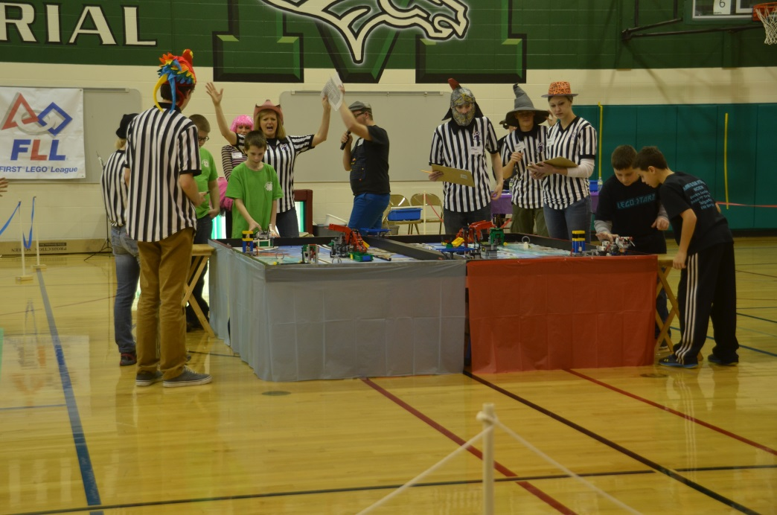
The Robot Game

Slide 15
Robot Games Advice
Practice, practice, practice! Just like the project presentation.
Have team members practice all planned missions while specializing in a few missions. In case they cannot participate.
Practice as a team, switching out, with a coach or team member timing the 2.5 minute run. Keep track of the score each time to see which missions are most successful/reliable.
Only two students at table, but can switch out other members nearby. All can come in for emergency repair.
Students allowed to discuss scoring rubric with ref before signing to finalize. Students only, coaches not allowed. Also coaches can not offer guidance during Robot Run.
Have Fun ☺ What we discover is more important than what we win.

Slide 16
Team management advice
Guide your team to a method for making decisions – you can start this with figuring out the team’s name (can change name until qualifier registration).
Ask guiding questions.
Some teams begin the season by having the team members sign a Teamwork Pledge.
Help the team create a time line for the season. Be prepared to check your progress with the timeline and update often. You can use the team tasks on the coaches corner and FIRST’s Coaches Handbook as guides.
Let the Core Values be part of your practice. You can discuss one at each practice. Use the core values language as you work with the team.
Read FIRST’S Coaches Handbook!

Slide 17
Practices
Most teams meet once or twice a week for a total of 2-4 hours
Begin team practices with a short meeting, (as team develops, kids lead)
Report on any homework
Today’s Goals and Objectives
Split into teams to work
Kids work on robot and project.
Take breaks, have snack and do Team-Building Activities
End of meeting – have various groups report to each other.
Specializing is ok… but everyone is responsible for all parts
Judges will ask everyone questions

Slide 18
Important Dates
Now: Get to know each other, brainstorm project, build challenge set, create a timeline. Register and order your supplies if you have not already.
Registration Oct 9th: Registration for qualifiers opens – sign up to celebrate all that your team has discovered this season. Embe.org
Qualifiers: Dec. 1: Memorial Middle School, Sioux Falls
Dec. 8 School of Mines, Rapid City
Dec. 15 Memorial Middle School, Sioux Falls
Championship: Feb. 2 Augustana University, Sioux Falls

Slide 19
Odds and Ends
Fundraising: If you have a sponsor/donor please see the instructions in the coaches corner and thank them via t-shirt or sign at competitions
Competitions: They are a celebration of the season! Quite often who advances to the next competition is determined by the team’s exhibition of core values.
Coaches Handbook: Useful!
Coaches Corner: http://embefllcoachescorner.weebly.com/ look here for project and programming resources as well as links to FIRST pages and an archive of coaches emails.
Facebook Group: Http://www.facebook.com/Groups/SDFLL
https://www.youtube.com/user/FLLGlobal - channel includes project videos, ask an expert, challenge videos
If you plan on bringing flare to competitions, please make it peanut free. Flare from the past: buttons, stickers, candy/food, bracelets
Be sure and keep up with Challenge Updates on FIRST’s website.

